Slide 1
Paper Presentation Deep Compositional Question Answering with Neural Module Networks
Reporter: Xuan Chen
Student #82286956

Slide 2
List
Problems being solved
Why is it valuable?
Contributions
Model architecture
Experiments
Conclusions.

Slide 3
Problems being solved
VQA (visual question answering ) model: monolithic network & Neural modular network
Neural Module Networks (NMNs), is a framework for modular, composable, jointly-trained neural networks. A network model is tailored to each question in the VQA dataset.
Enhanced interpretability of the network

Slide 4
Why is it valuable?
There is no single “best network” for all computer vision tasks.
Thinking of question answering as a highly-multitask learning setting, where each problem instance is associated with a novel task, and the identity of that task is expressed only noisily in language.
Problem-dependent and dynamic.
Intuitive, interpretable model, and transparent process.

Slide 5
Main contributions
It first describes an approach to visual question answering based on neural module networks (NMNs). It answers natural language questions about images using collections of jointly-trained neural “modules”, dynamically composed into deep networks based on linguistic structure.
The NMN performs well on answering object or attribute questions.
Introduction of SHAPE dataset.

Slide 6
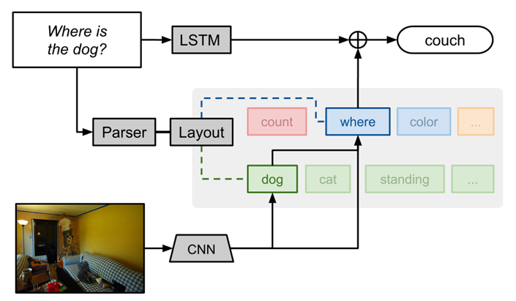
Model architecture

Slide 7
Part 1: Modules
Three basic data types: images, unnormalized attentions, and labels.
Form: TYPE [INSTANCE] (ARG1,…)
TYPE: a high-level module type (attention, classification, etc.)
INSTANCE: the particular instance of the model under consideration.
attend[red]: locates red things
attend[dog]: locates dogs.

Slide 8
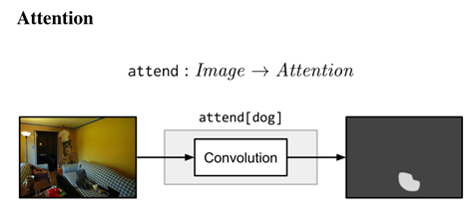
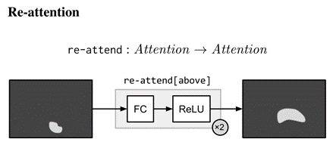
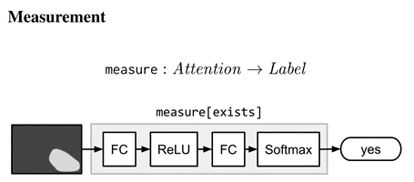
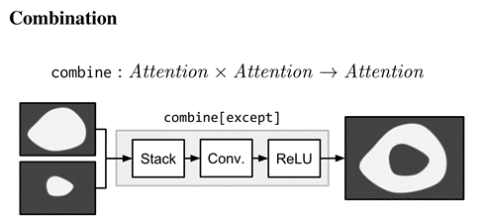
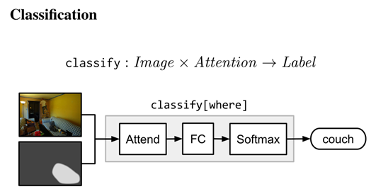
Part 1: Modules

Slide 9
Part 2: From strings to networks
Parsing: Using Stanford Parser, extract grammatical relations between parts of a sentence, and generate abstraction; performs basic lemmatization.
Layout: Based on specific tasks, converts symbolic representations into modular network structure.
Leaves: attend modules.
Internal nodes: re-attend modules/combine modules.
Root nodes: measure modules for yes/no questions and classify modules for all other questions.
Generalizations: provide sentences, or even direct query statements like sql.

Slide 10
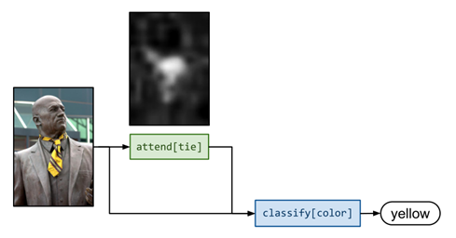
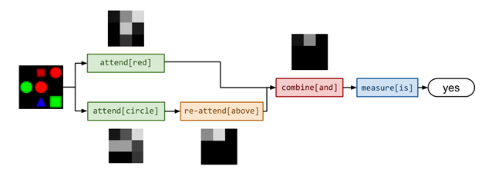
Sample NMNs for question answering
(a) NMN for answering the question What color is his tie?
(b) NMN for answering the question Is there a red shape above a circle?
Notes:
Sample NMNs for question answering about natural images and shapes. For both examples, layouts, attentions, and answers are real predictions made by our model.

Slide 11
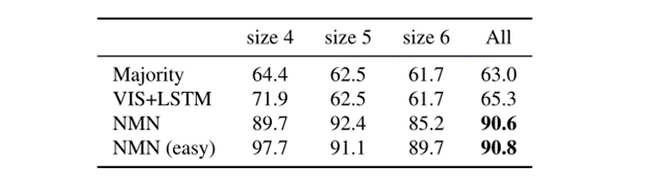
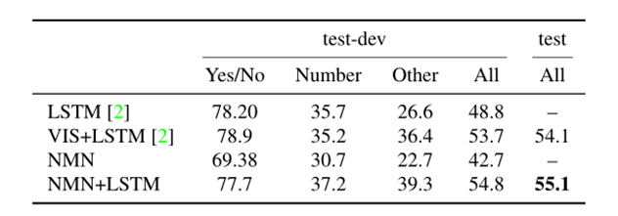
Experiments
Results on different datasets: SHAPE dataset(up), VQA dataset(down).

Slide 12
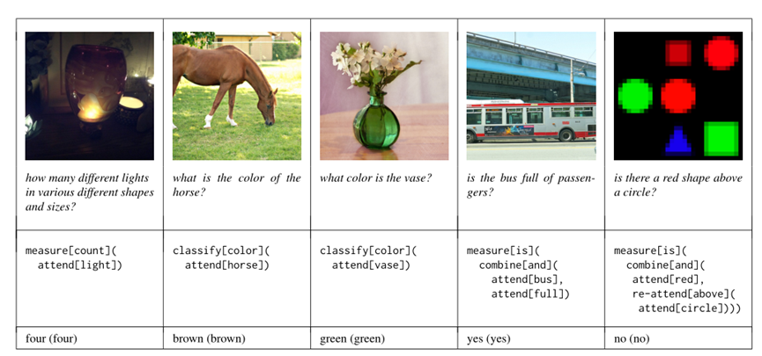
Correct cases:

Slide 13
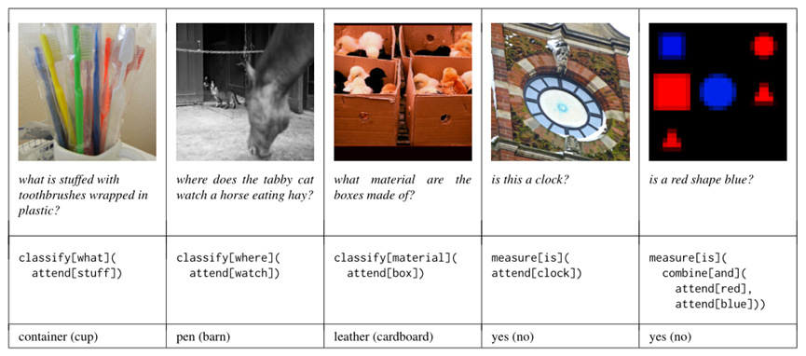
Wrong cases:

Slide 14
Conclusion
Previous work: focus on attention, but the process of question answering can not be explained properly.
This paper: introduces Neural Module Networks, which is made up with several modular networks. It is customized by every question in VQA dataset (dynamically).
Generate a more standard neural network → construct models → complex reasoning tasks

